Slide 1
Instagram user analytics
Abhishek adyani

Slide 2
Project description
Analyzing user interaction and engagement with the Instagram app to provide valuable insights that can help the business grow, The insights derived from this analysis can be used by various teams within the business, insights are then used by various teams across the business as for marketing team it will be used for launching a new campaign or for the product team for building or removing features, or for developer team to improve the overall experience.

Slide 3
Approach
For this project, I have used my SQL knowledge about various clauses and functions like join function, where clause, aggregation, group by, order by and many other functions that are required, as I have extracted the data from the given database, keeping primary and foreign key in mind.
I have answered every query from the marketing department as well as investors metrics department

Slide 4
Tech-Stack Used
I have used MYSQL workbench 8.0.36 community version by connecting to my local server with the given database, I chose this software as it is very user friendly and a great tool to analyze the data

Slide 5
Insights
Following are the insights across various departments :

Slide 6
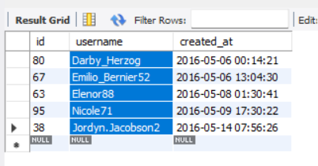
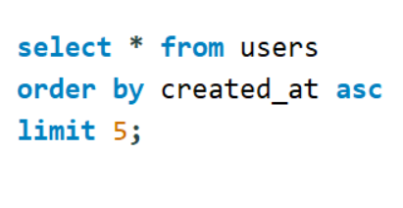
A) Marketing Analysis 1) Loyal User Reward
Those who have been using the platform for the longest time are:
Darby_Herzog, Emilio_Bernier52, Elenor88, Nicole71, Jordyn.Jacobson2
Code used :

Slide 7
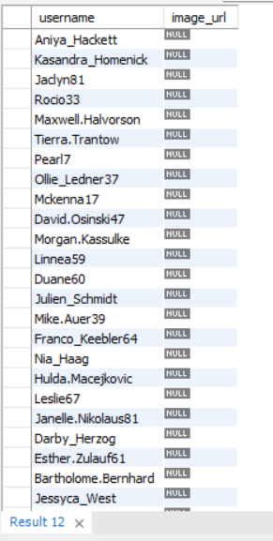
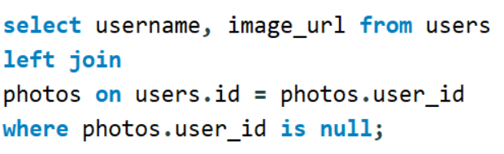
2) Inactive User Engagement
Result: :
User who have never posted a single photo on Instagram are 26 people.
Code used :

Slide 8
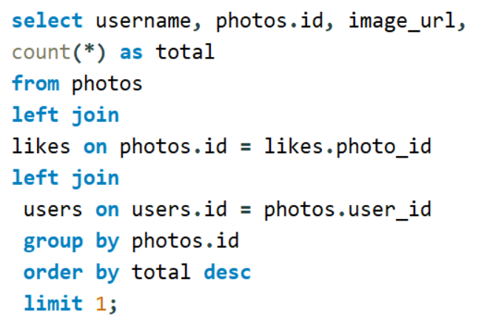
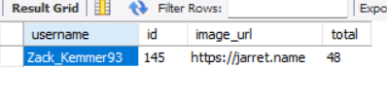
3 ) Contest Winner Declaration
the user with the most likes on a single photo on Instagram is: Zack_Kemmer931 having 145 likes code used:
Result:

Slide 9
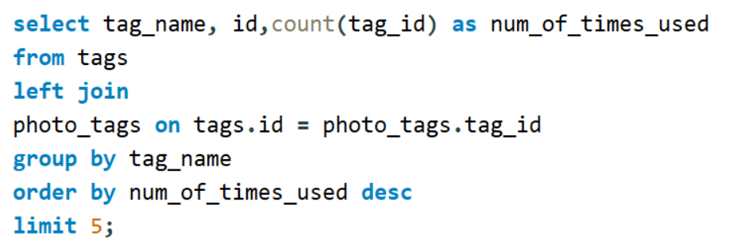
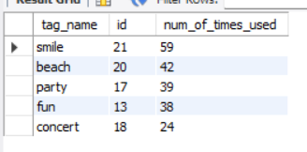
4) Hashtag Research:
the top five most commonly used hashtags on the platform are : smile, beach, party, fun, concert
Code used:

Slide 10
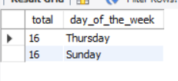
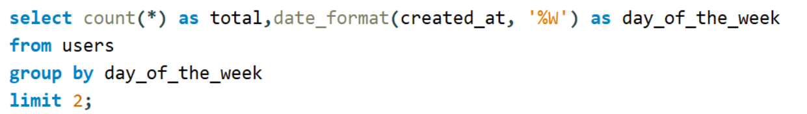
5) Ad Campaign Launch:
the day of the week when most users register on Instagram are : Thursday and Sunday, as both of them have equal number of posts per day.
Code used:

Slide 11

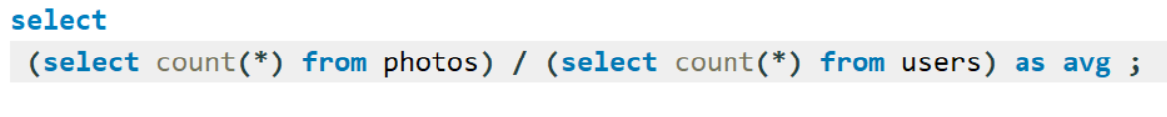
b) INVESTORS METRICS
1) User Engagement:
the average number of posts per user on Instagram is 2.5700.
Code used:

Slide 12
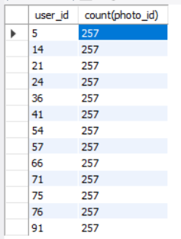
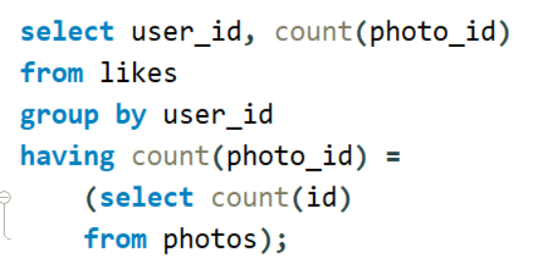
2) Bots & Fake Accounts:
users (potential bots) who have liked every single photo on the site are 13 bots.
Code used:

Slide 13
Key takeaway
Darby_Herzog, Emilio_Bernier52, Elenor88, Nicole71, Jordyn.Jacobson2 are the oldest users on Instagram.
There are 26 users who have not posted a single photo.
Zack_Kemmer931 having 145 likes won the contest of most likes on a single photo on instagram
smile, beach, party, fun, concert are the top five most commonly used hashtags on Instagram
Thursday and Sunday are the best day of the week to launch Ads
2.570 is the average number of post per user on Instagram
There are a total of 16 bots or fake accounts who have liked each and every post on Instagram.

Slide 14
Thank You

